Slide 1
Estimating Californian Housing Prices through processes of machine learning
Authors: Beck Allen & Kent Kenyon

Slide 2
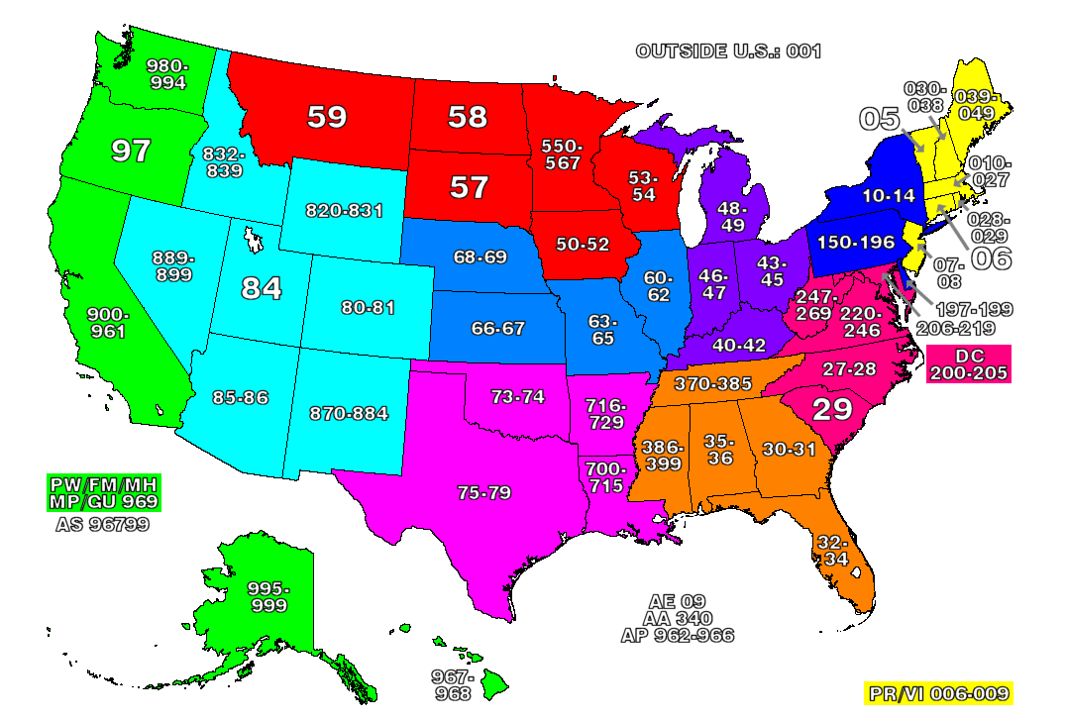
Initial goal
Create a program that estimated a houses value based on parameters like Our original idea was to create housing estimates based on the Square Footage, Number of Bathrooms, Number of Bedrooms, Year Built, and geographical factors such as the Median Income, Nearest School(miles), and population within a given Zip Code
We were not able to find or extract a dataset that entirely matched the parameters we were looking for, yet found Californian houses with geographical parameters.

Slide 3
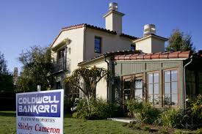
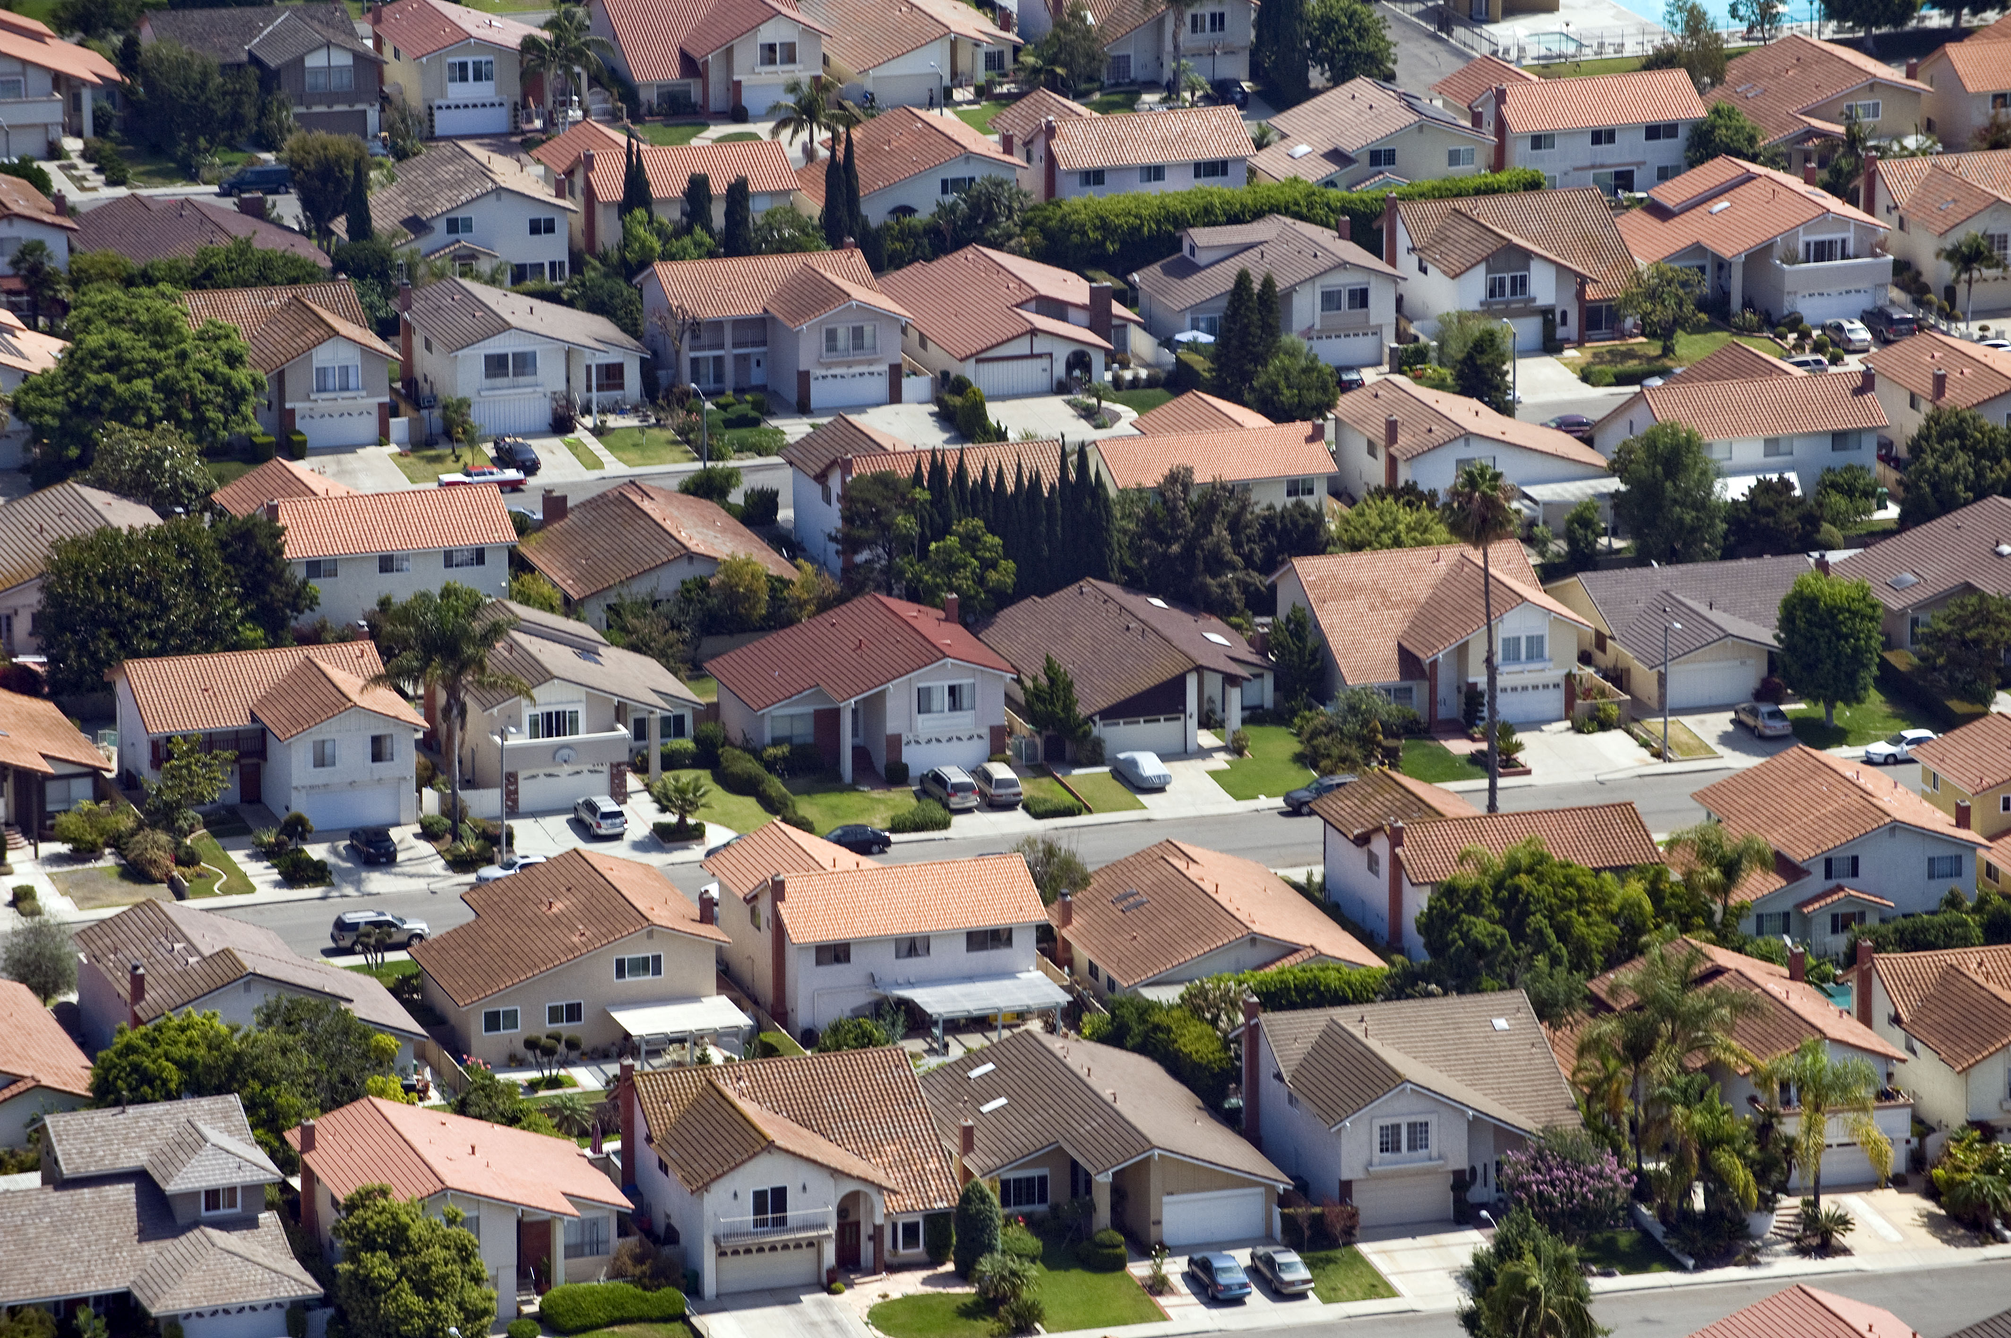
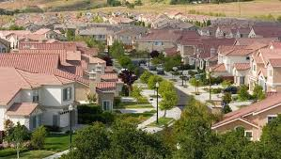
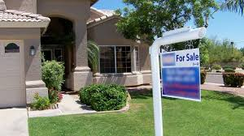
Data Selected
After vigorous searching and trying to find what data we could extract, we decided that a California housing dataset allowed for the geographical parameters that we were interested in: Longitude, Latitude, Ocean Proximity, Population, alongside other parameters like the Total Rooms, Total Bedrooms, Households, Median Income, and Housing Median Age.

Slide 4

Random Forest Algorithm
For this dataset, we decided to use the Random Forest Supervised Learning Algorithm, which builds “forests” , an ensemble of decision trees that is usually trained with the bagging method.
Random Forest is a very good predictive modeling tool that is popular for being diverse and a powerful machine learning algorithm.

Slide 5
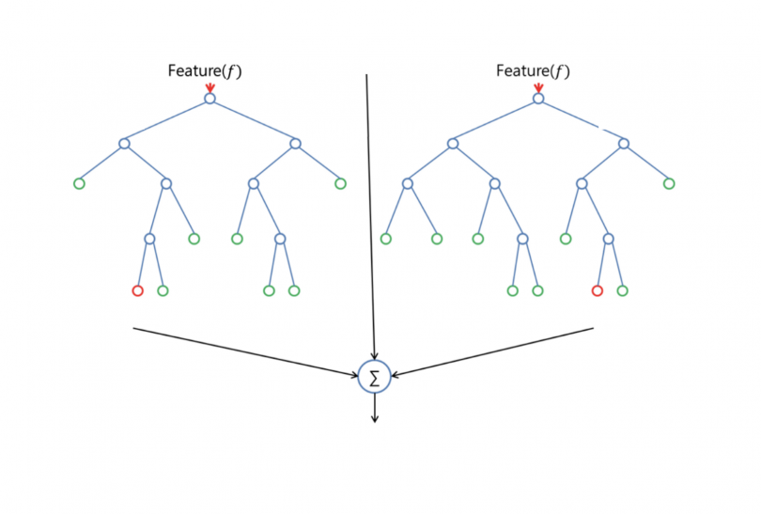
Random Forest Algorithm
This method leads to more accurate and stable predictions by avoiding overfitting through the creation of random subset of the features and building smaller trees from these subsets. Random Forest formulates rules which are used to make the predictions.
Random Forest is an ensemble learning algorithm that combines the predictions from multiple machine learning algorithms together to make more accurate predictions than any individual model.

Slide 6
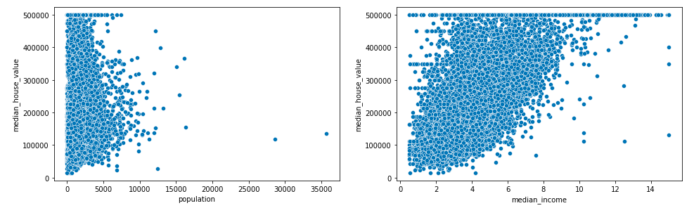
Visualization of Parameters
These graphs visualize two of the parameters of the Population and the Median Income for our Californian homes dataset of 20,640 homes.
These visualizations help indicate which parameters have a higher correlation to our Median House Value.

Slide 7
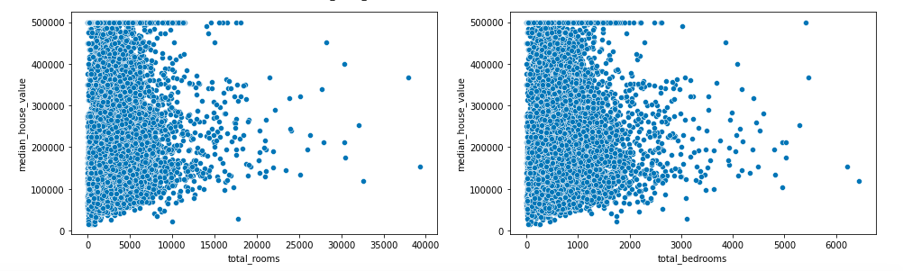
Square footage visualization
The graphs depict the visuals for the square footage for the Rooms and the Bedrooms.
Typically, one of these would want to be removed because of their similarity to reduce the risk of overfitting, yet the Random Forest Algorithm avoids noise as a robust algorithm.

Slide 8
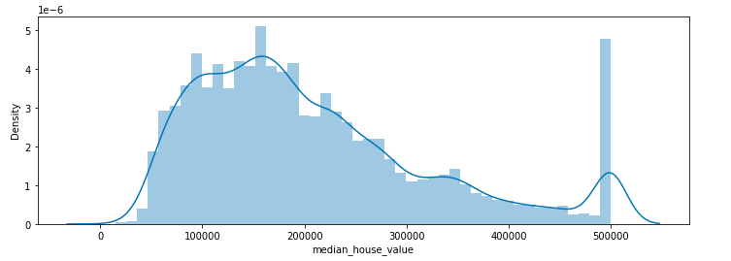
Median House Value Visualization
This shows the density of the Median House Value where we can distinguish that the bulk of samples is between the $100,000 to$ 200,000 range.
Note: Each recorded value is recorded to the nearest $100.

Slide 9
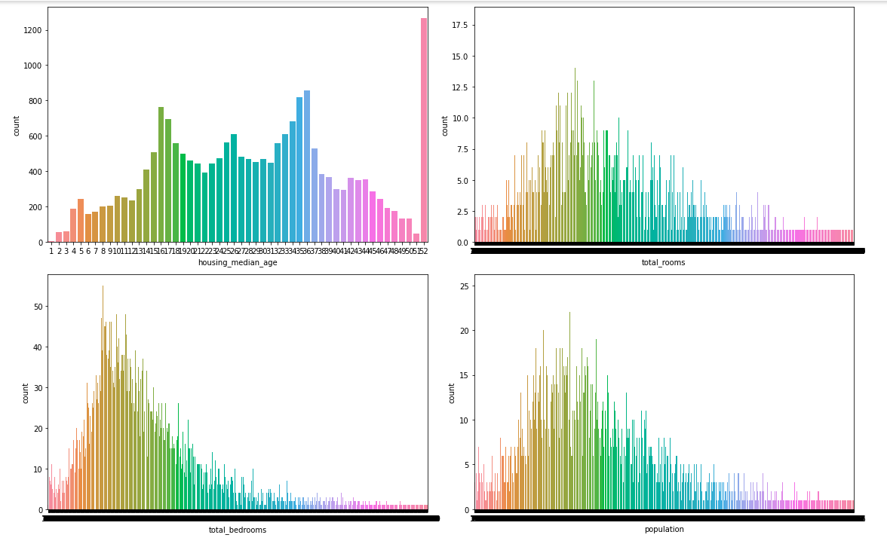
Data Visualization
These countplots help to better understand the data we are working with through histograms.

Slide 10

Training Accuracy and Test Accuracy
With the Random Forest Algorithm we were able to achieve a very high training accuracy with a still fairly high test accuracy. These scores could be improved by performing further tuning to our hyperparameters, such as changing the number of branches in our code with n_estimators.
In changing n_estimators so that we have more trees, we could increase the accuracy of predictions, yet it would also result in a slower model.

Slide 11
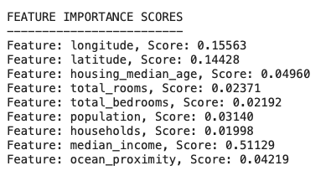
Feature Importance Scores
A main benefit of the Random Forest Algorithm is that it allows the user to view the relative importance the model assigns to the input features.

Slide 12
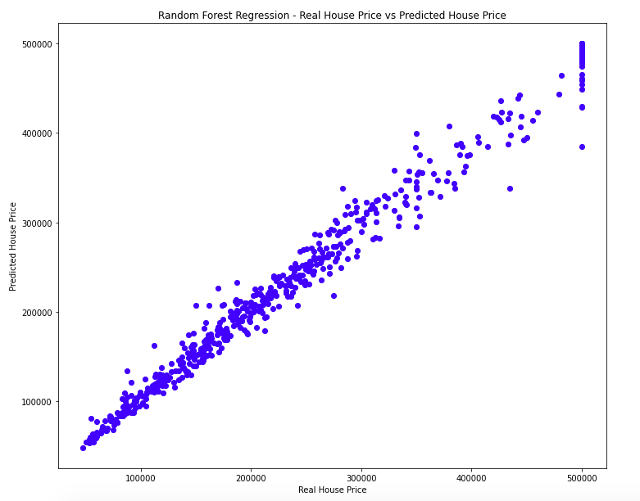
Correlation Between predicted and Real

Slide 13
Improvements
We plan to continue to Improve our data by tuning the hyperparameters so we can improve our Test Accuracy. We noticed that feature selection of the top three features brought a slight increase in accuracy when running the code for this Random Forest Algorithm.
A larger dataset that contained more parameters would also be beneficial towards creating more accurate housing price evaluations for Californian homes. Having more data typically results in stronger correlations and less assumptions.

Slide 14
Sources
Marie-Hélène Roy & Denis Larocque (2012) Robustness of random forests for regression,Journal of Nonparametric Statistics, 24:4, 993-1006, DOI: 10.1080/10485252.2012.715161
T. Ho, "Random decision forests," in Proceedings of 3rd International Conference on Document Analysis and Recognition, Montreal, Quebec, Canada, 1995 pp. 278. doi: 10.1109/ICDAR.1995.598994 url: https://doi.ieeecomputersociety.org/10.1109/ICDAR.1995.598994

